Slide 1
Book1
File created on: 29-11-2021 21:34:32

Slide 2


Slide 3
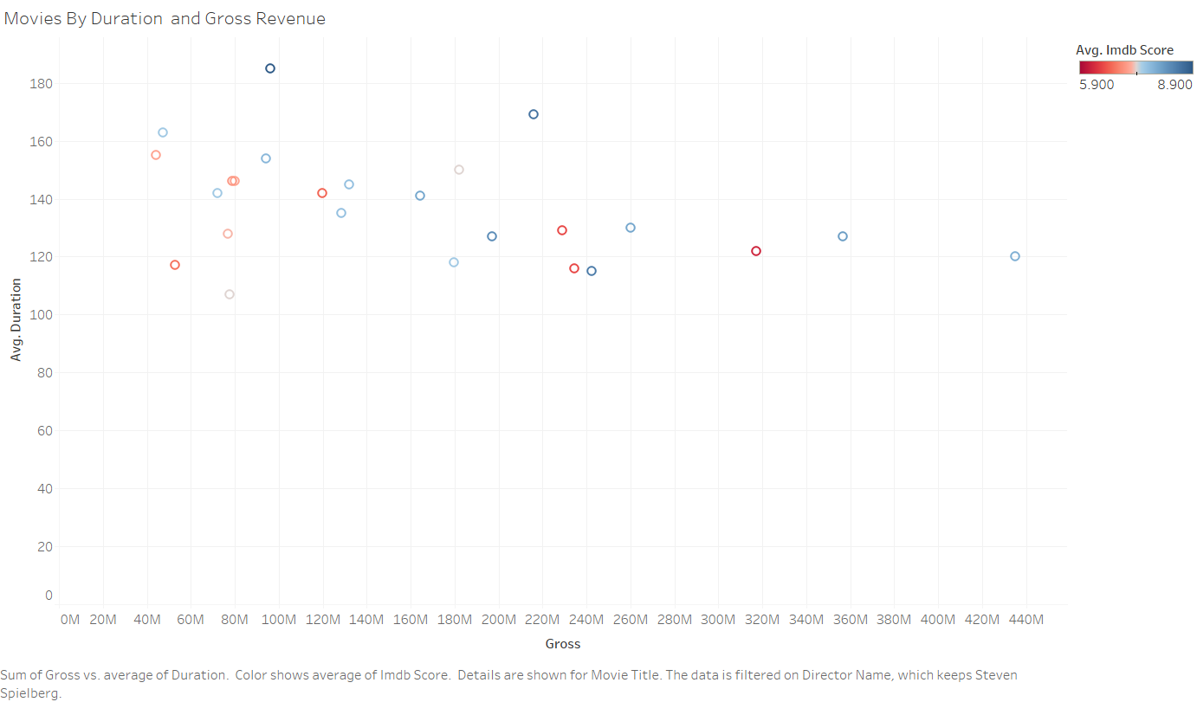

Slide 4
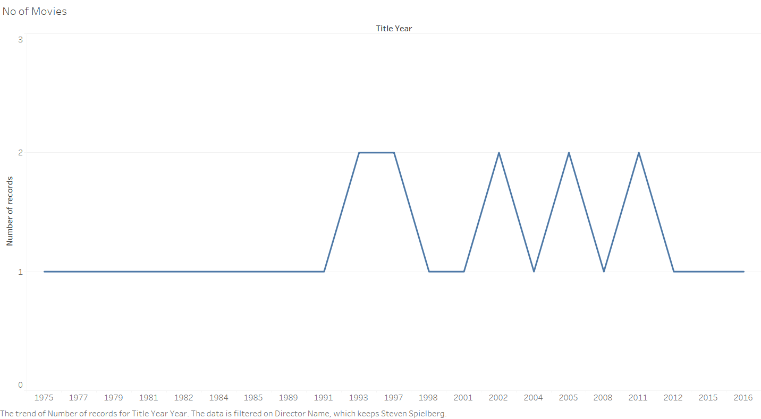

Slide 5
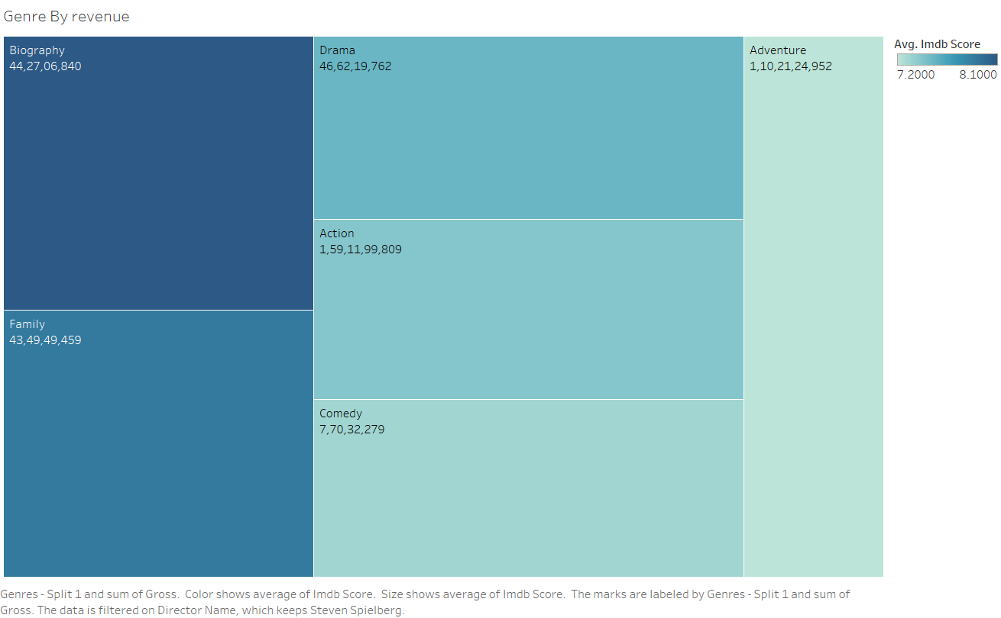

Slide 6
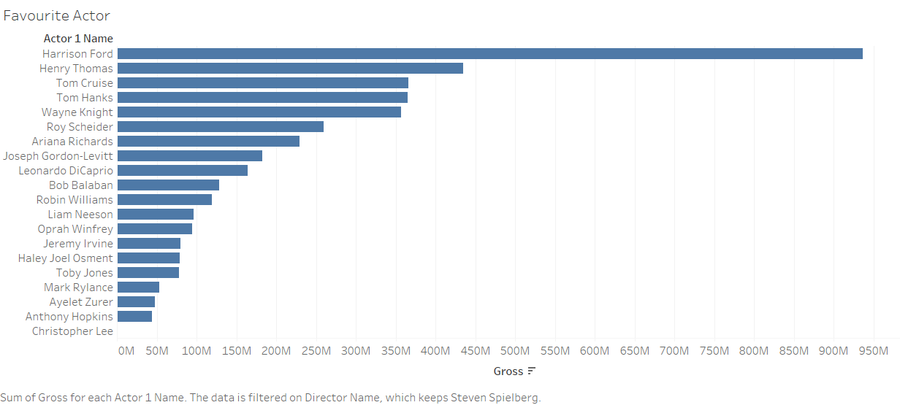

Slide 7
